Slide 1
AI Multi-Agent Sales Pipeline Assistant
Automating lead qualification, follow-ups, and CRM workflows using collaborative AI agents.

Slide 2
Problem
Sales teams spend large time on repetitive tasks:
  Manual lead qualification
  Writing follow-up emails
  Scheduling reminders
  Updating CRM systems
Leads are often lost due to delayed responses.
Goal
Build an intelligent system that automates the entire sales workflow.

Slide 3
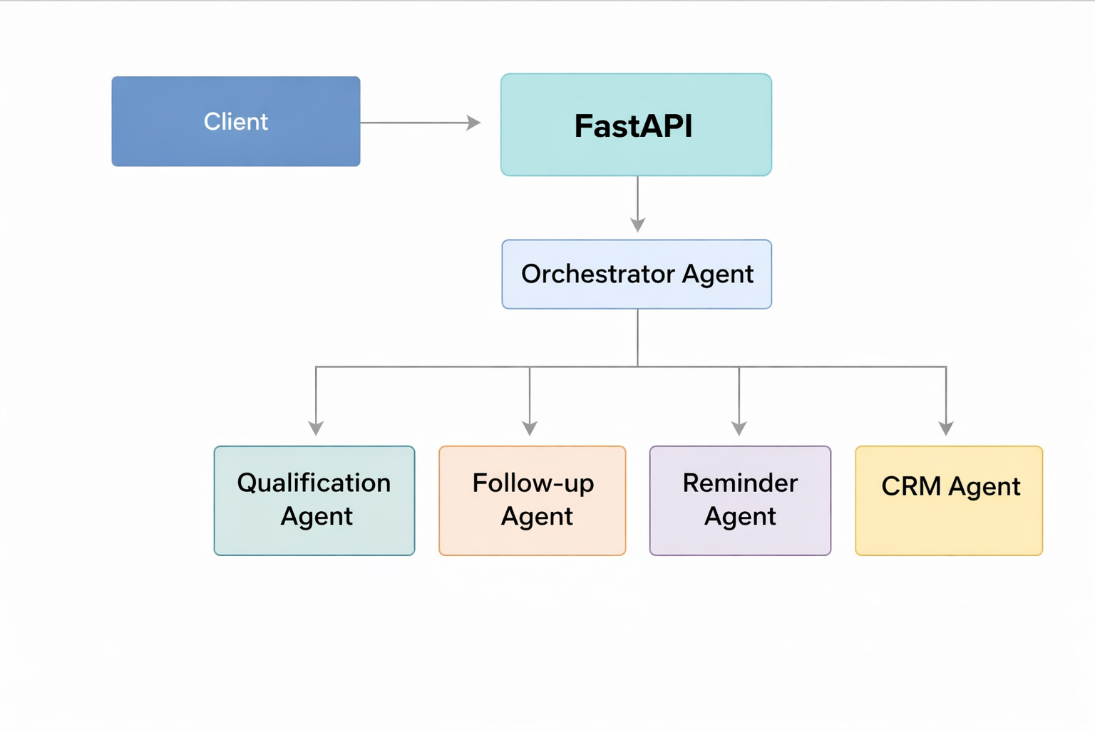
Instead of one AI doing everything, we divide responsibilities like a real sales organization.

Slide 4
How It Works
User submits a lead via API
Qualification Agent analyzes intent
Follow-up Agent generates outreach email
Reminder Agent schedules next action
CRM Agent produces structured summary

Slide 5
Example Input
{
"name": "Sia Jon",
"company": "TechGig",
"interest": "AI automation",
"budget": "High",
"timeline": "Immediate"
}

Slide 6
User Agent Execution:
Qualification Agent analyzing...
Follow-up Agent drafting email...
Reminder Agent scheduling...
CRM Agent summarizing…
Impact
Reduces manual sales effort
Faster lead response time
Consistent communication
CRM-ready automation

Slide 7
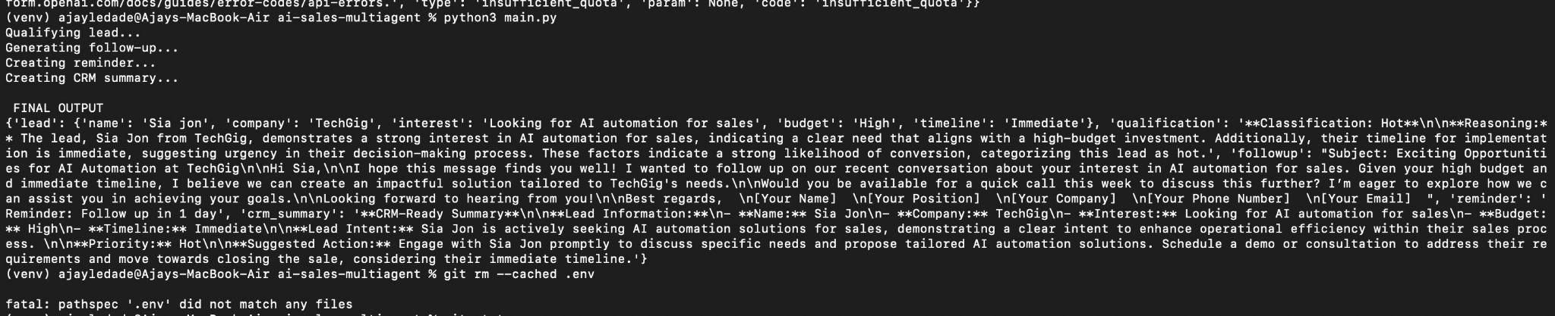
Output:

Slide 8
